Slide 1
Eco-Evolutionary Optimality (EEO) Models

Slide 2
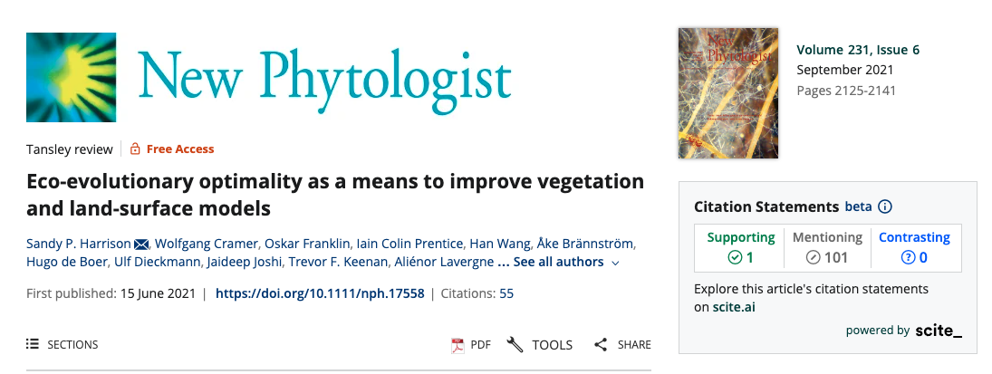

Slide 3
EEO invokes the power of natural selection to eliminate uncompetitive trait combinations, and thereby shape predictable, general patterns in vegetation structure and competition.

Slide 4
Where’d the name EEO come from?
Eco: trait adjustments can happen through ecophysiological responses on short time scales
Evo: trait adjustments can occur over evolutionary time scales

Slide 5
Some EEO examples

Slide 6
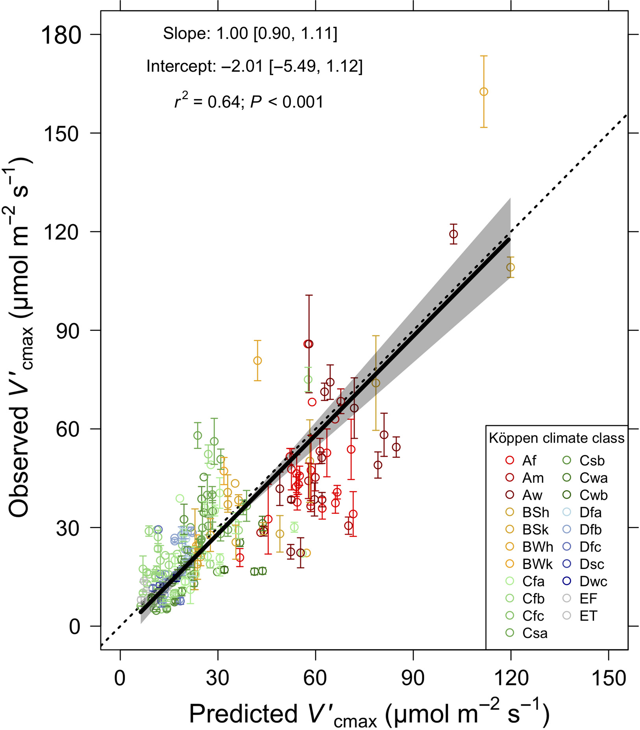
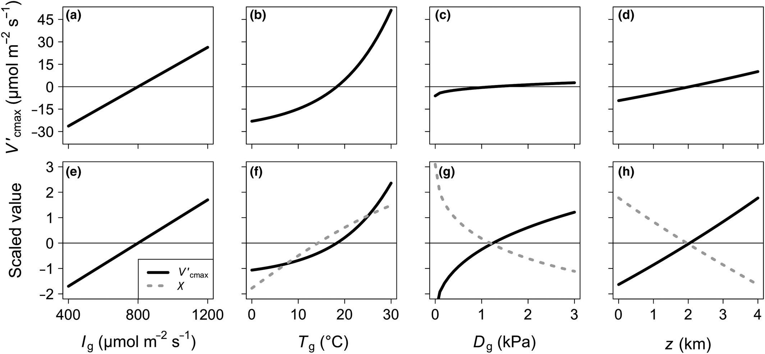
Photosynthetic capacity
Smith et al. (2019)

Slide 7
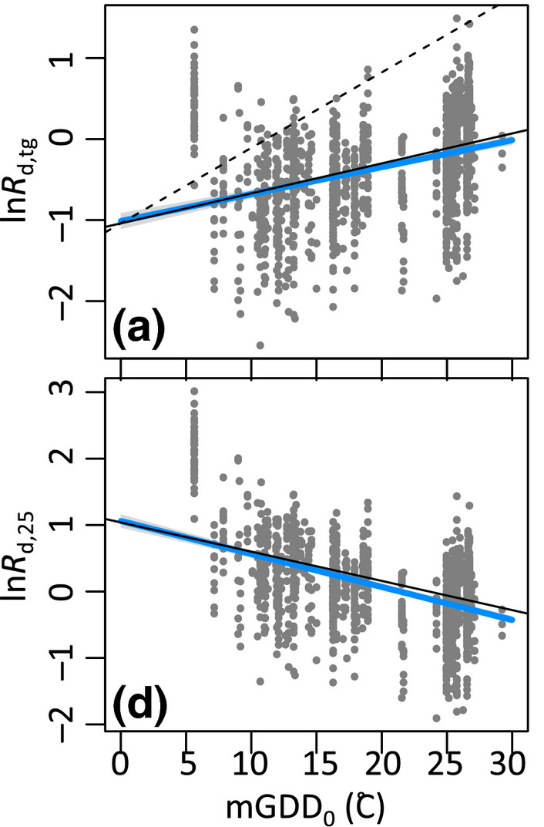
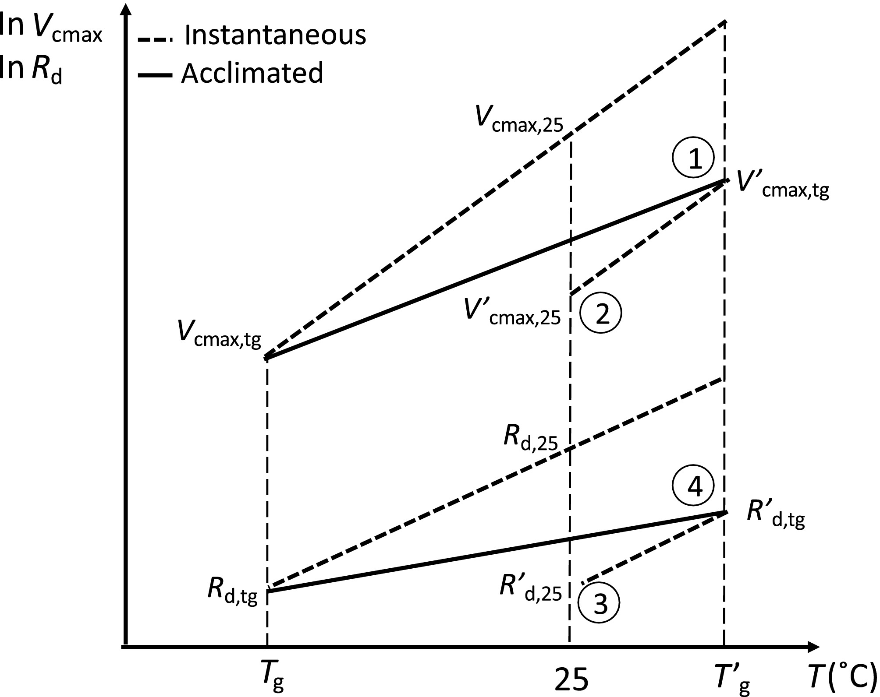
Dark respiration
Wang et al. (2020)

Slide 8
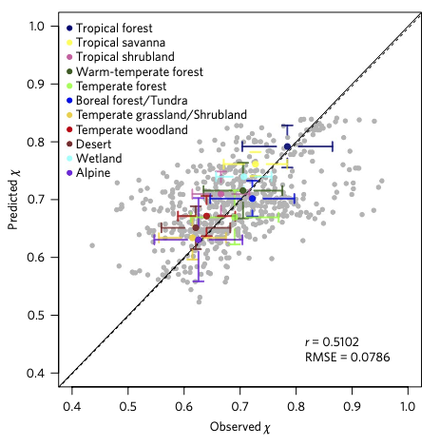
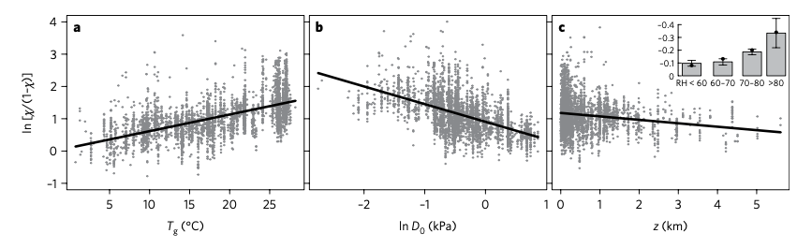
Stomata
Wang et al. (2017)

Slide 9
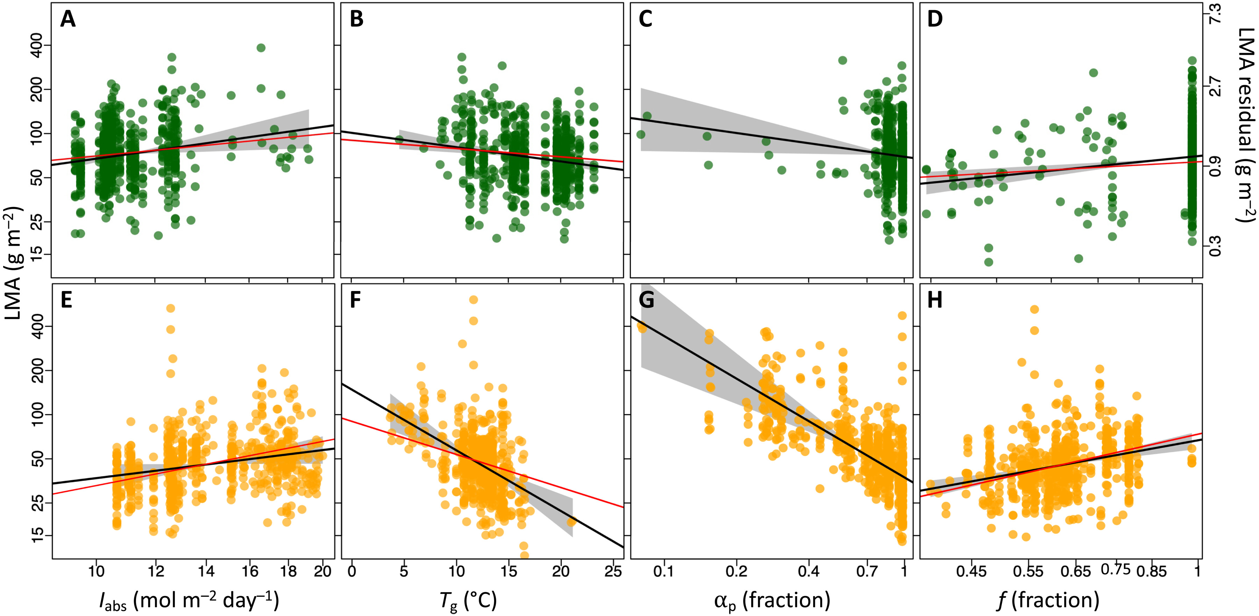
LMA
Wang et al. (2023)

Slide 10
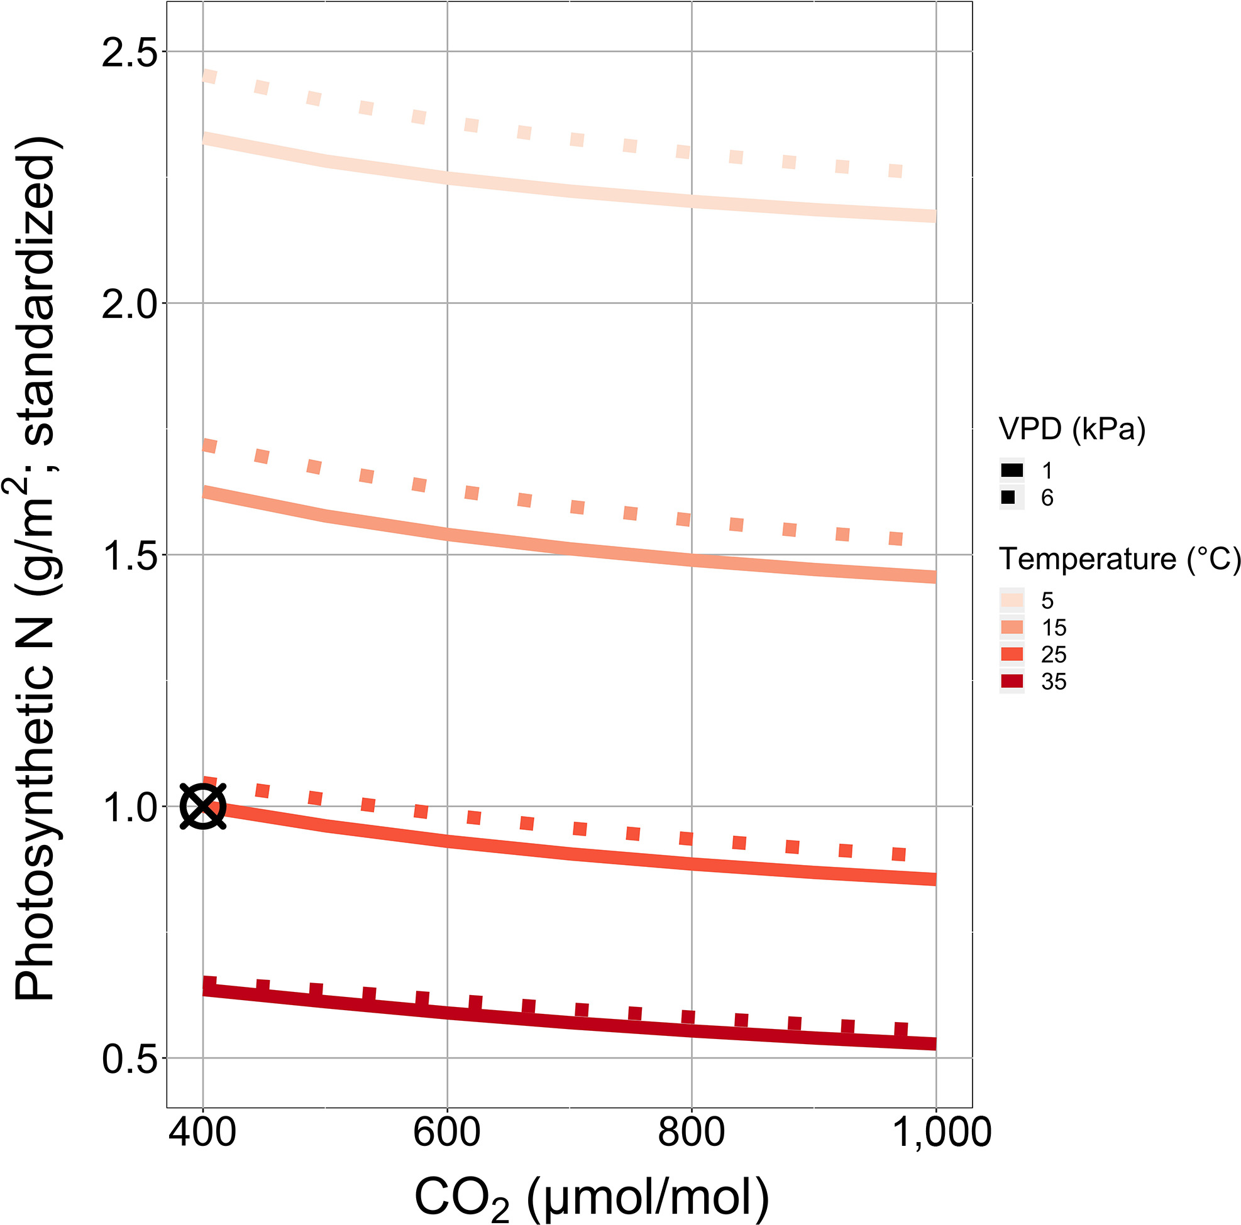
Leaf N
Smith and Keenan (2020)

Slide 11
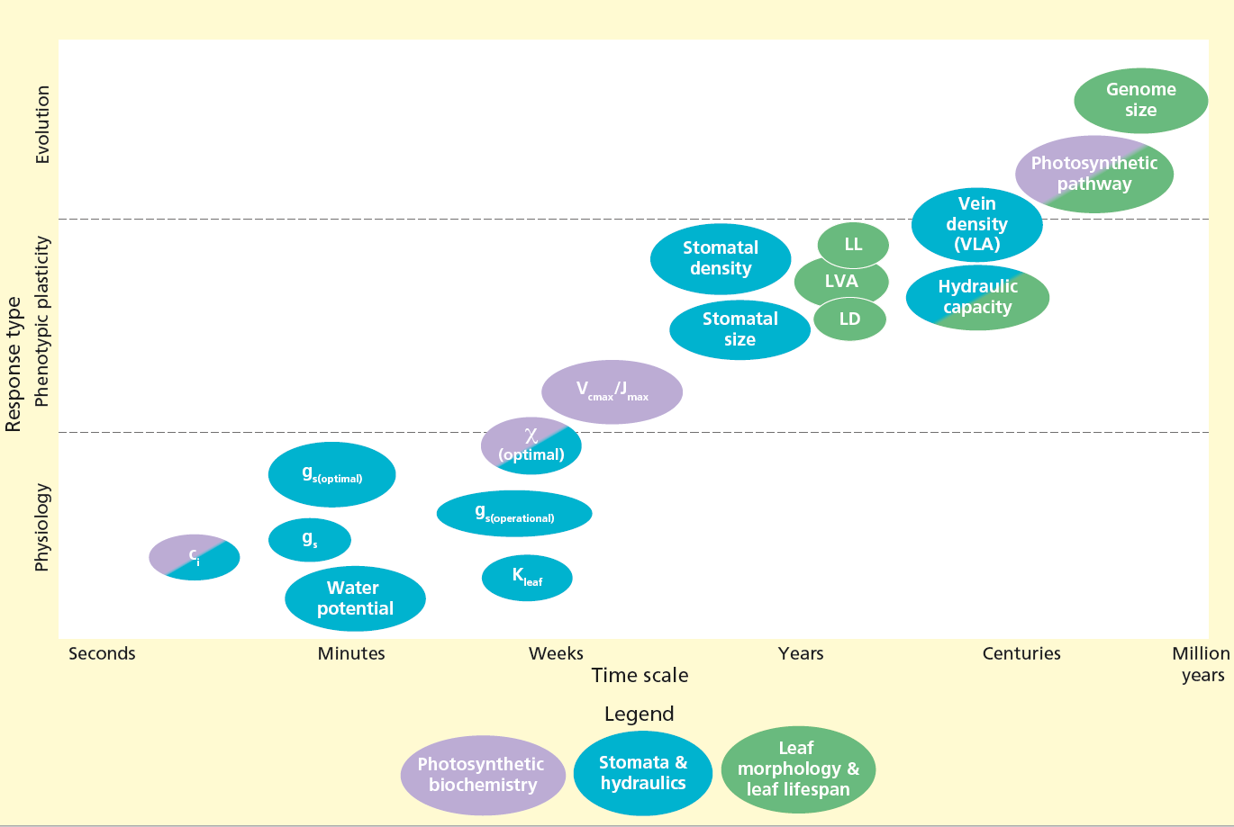
Timescale sidebar: there could be many!
Ode et al. (in review)

Slide 12
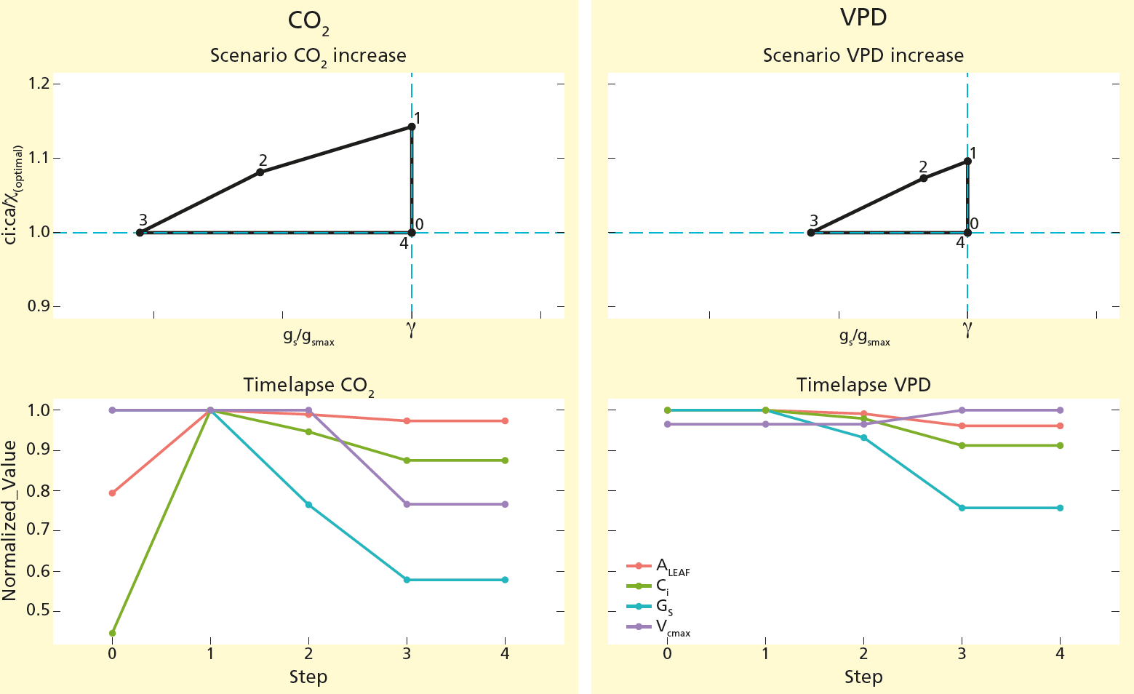
Ode et al. (in review)

Slide 13
EEO hypothesis development is based on trade-offs. Does your module process represent a trade-off?

Slide 14
Model development problems and solutions
Problem: models do not encapsulate a coherent body of theory
Solution: integrate testable theories and test one-by-one

Slide 15
Model development problems and solutions
Problem: lack of clarity about hypotheses
Solution: test processes independently

Slide 16
Model development problems and solutions
Problem: core process representations tend to be conserved
Solution: revisit and reevaluate core processes

Slide 17
Model development problems and solutions
Problem: neglect of available observations
Solution: use observations to test core assumptions (experiments are critical!)

Slide 18
Does your module represent a testable theory?

Slide 19
Moving beyond the leaf
Carbon allocation
Allocation to limiting pool
Soil-plant interactions and mycorrhizae
Additional allocation constraints
Competition and coexistence
Game theory

Slide 20
Moving beyond

